Slide 1
Woodland Public Schools
Facilities and Safety Report
November 2016

Slide 2
FACILITIES REPORT
Combustable Gas detectors – I have been working with Cascade natural Gas’s subcontractor getting a proposal to install a combustible gas detector system for WMS. Most of the schools use natural gas for heating water and distributing the water to HVAC equipment through out the schools. WMS is a unique in that all of the classrooms use natural gas to heat the rooms through an indirect heat exchanger. This requires natural gas to be plumbed the length of the yellow and green halls directly above the rooms. This installation requires multiple mechanical joints and flexible connections in the attic space directly above the rooms. This system will detect a leak and alarm to the WMS office forcing an evacuation of the school. The system will also be capable of isolating the gas supply to the school should a leak develop.
Emergency Action plan – I am waiting for the reunification Memorandum of Understanding (MOU’s) before issuing the plan to the Superintendent. Once these documents are receive a final edit will be completed and the plan will be submitted.
Card Key Access System – All final proposals have been received for the card key access systems for WPS, WIS, WMS. A final review of the proposals is in progress. A recommendation letter will be submitted to the board for financial approval. System installation is approximately 6-8 weeks and if all goes smoothly, I would expect the system to go live at spring break.

Slide 3
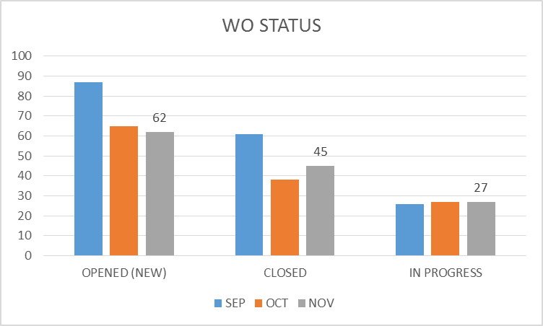
FACILITY CHARTS – POWER COST AND WORK ORDER STATUS

Slide 4
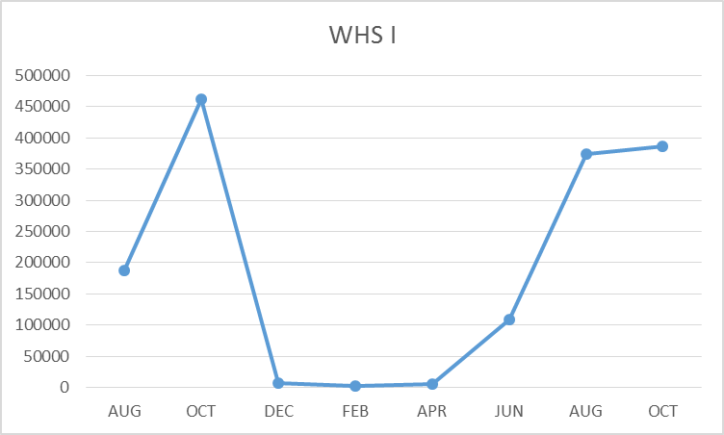
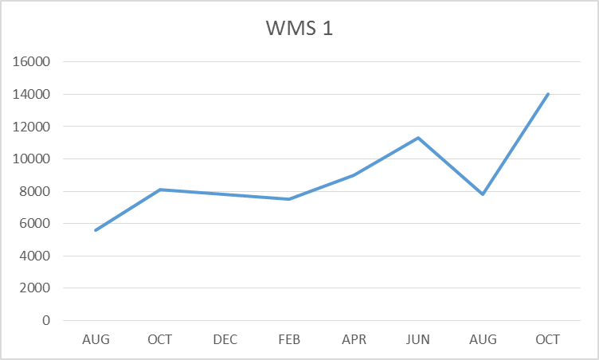
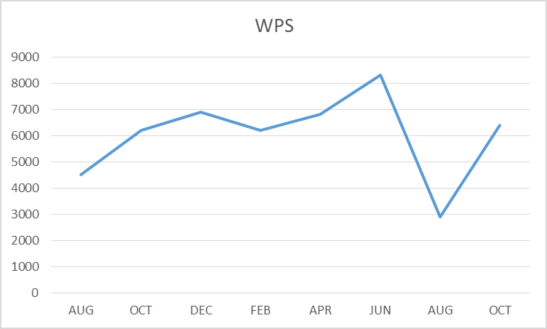
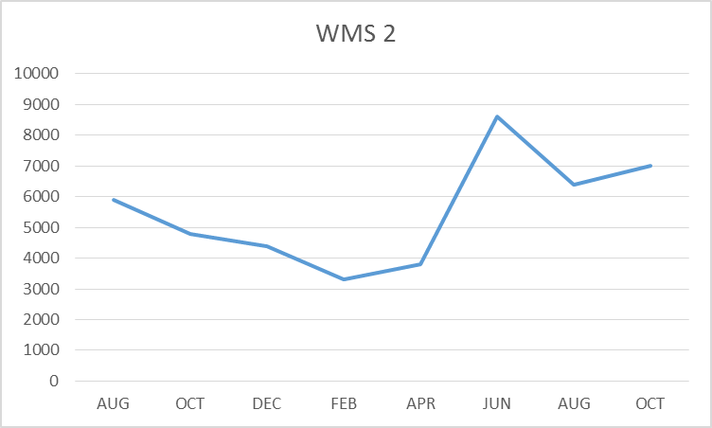
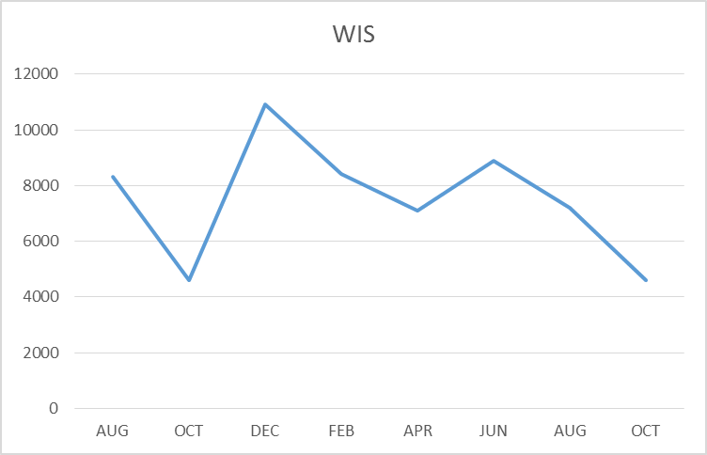
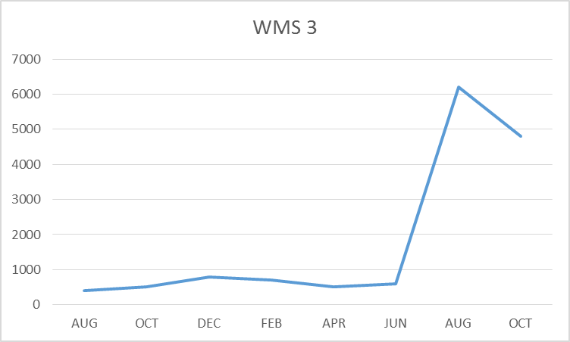
FACILITY CHARTS – WATER USAGE, WHS, WIS, WMS, WPS
Water bills are issued every two
months. Next update on these graphs will be in January (Decembers report)

Slide 5
SAFETY
Accidents for the month
There were a total of 11 injuries in the month of November 3 students and 8 staff members.
Staff Accidents/Incidents (8)
WPS – Student kicked and hit employee
WPS – Student kicked IA multiple times
WPS – Student threw chair at teacher
WPS – Student hit employee in the arm
WPS – Student bit IA
WPS – Student struck IA in face and pulled her hair
WIS – Employee slipped on wet floor
WPS – Employee slipped on wet floor
Student Accidents/injuries
WPS – Student received head injury from play equipment (student was pushed)
WPS – Student slipped on wet floor
WHS – Student dropped bench on foot

Slide 6
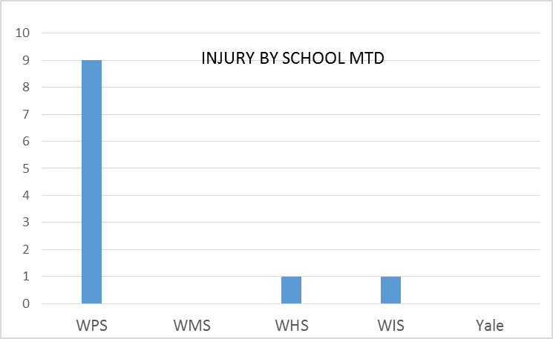
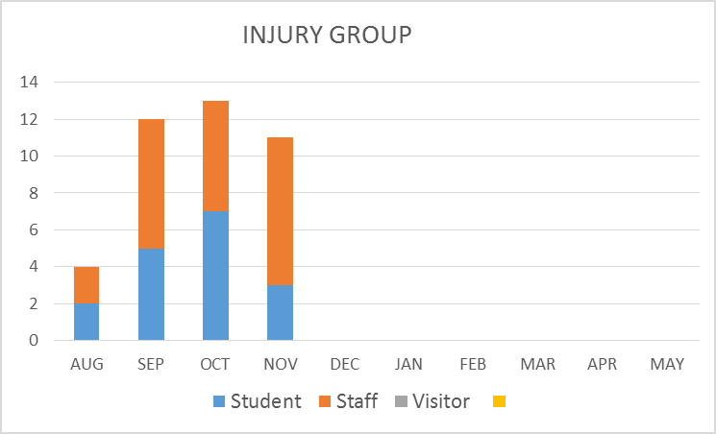
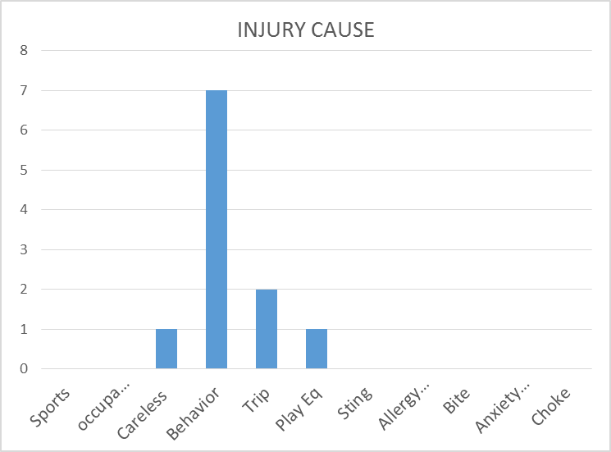
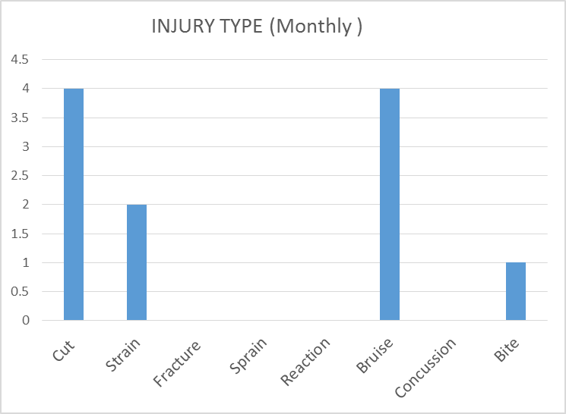
SAFETY CHARTS

